Slide 1


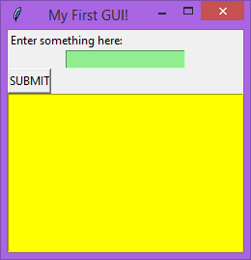
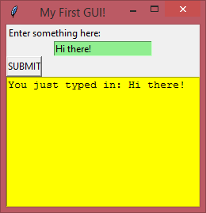
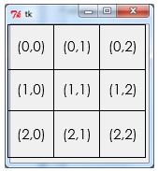
GUI Building with TKinter
Lesson 4 – Saving & loading with dictionaries & text files

Slide 2


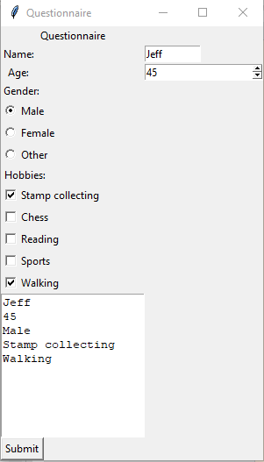
Activity 1
Load the questionnaire program you made last lesson, or download a copy of the “lesson 3 walkthrough solution” code from Google Classroom
Did you manage to get any form of saving and loading working in lesson 2?

Slide 3
Today’s lesson
Introduction
At this stage, you have learned the majority of what you need to create a simple GUI application which takes in some data from the user and returns an output.
Another key feature of most software applications is the ability to save and load data, which is what you will be exploring today.
Learning Objectives:
Understand how text files can be opened from Python and the different access modes
Explore using the different methods of writing data to a text file
Explore using the different methods of reading data from a text file
Implement methods of saving and loading data into your questionnaire program

Slide 4
Tkinter – saving & loading
There are 3 main methods of saving & loading data from a Tkinter program. The first is using something called “pickle”, which is a pre-written library. Some of you may have experimented with this for the lesson 2 extension.
In the exam however you don’t need to use pickle (although you could if you wanted to!), so we’re going to look at 2 alternatives.
The first is to extend the dictionary method we were using in lesson 2 to store the data that is generated when the user enters information. This will involve putting new dictionaries into a list, then saving and loading the list from a file.
The second is a slightly odd method which the WJEC like to use which doesn’t use a conventional data structure, but instead saves data directly to a file in a sort of spaced out table. More on this one later!

Slide 5
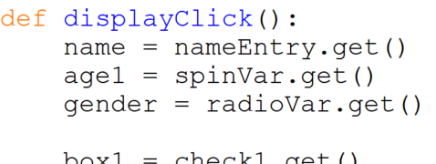
Tkinter – saving & loading
Method 1 - Saving a dictionary
In the lesson 3 tutorial you made a button called “button” and a function called “on-click” for the command. (If you downloaded the code from Google Classroom, the button is called “submit” and the function is called “submitClick”.)
It is a good idea to use more “self-identifying” names for our variables and functions, so let’s rename the button to “display”, and the function to “displayClick”

Slide 6
Tkinter – saving & loading
Method 1 - Saving a dictionary
Now we need to make a new button called “saveButton” or similar.
Add this code in after the display button, but before the window.mainloop() line:
Don’t run the code yet though – we haven’t done the saveClick function.

Slide 7
Tkinter – saving & loading
Method 1 - Saving a dictionary
At this point, save a copy of your code and call it “lesson 4 activity 3”. You will need this later on, but for now go back to the copy of the code you were working on.

Slide 8
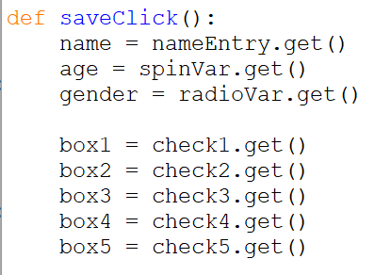
Tkinter – saving & loading
Method 1 - Saving a dictionary
Above the displayClick function, make a new function as shown below:
These first 8 lines are the same as those in the displayClick function because we need to fetch the same information so that it can be saved.

Slide 9
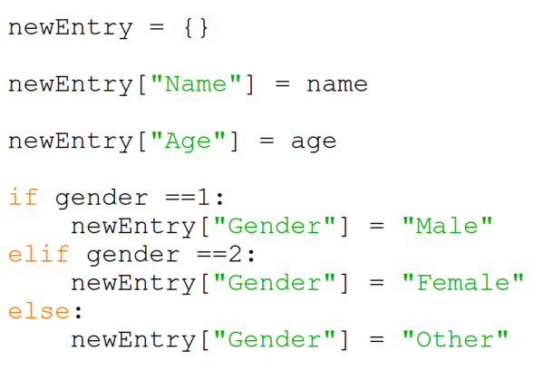
Tkinter – saving & loading
Method 1 - Saving a dictionary
Next we need a new empty dictionary which we will be adding the information to, then start filling it based on the inputs made.

Slide 10
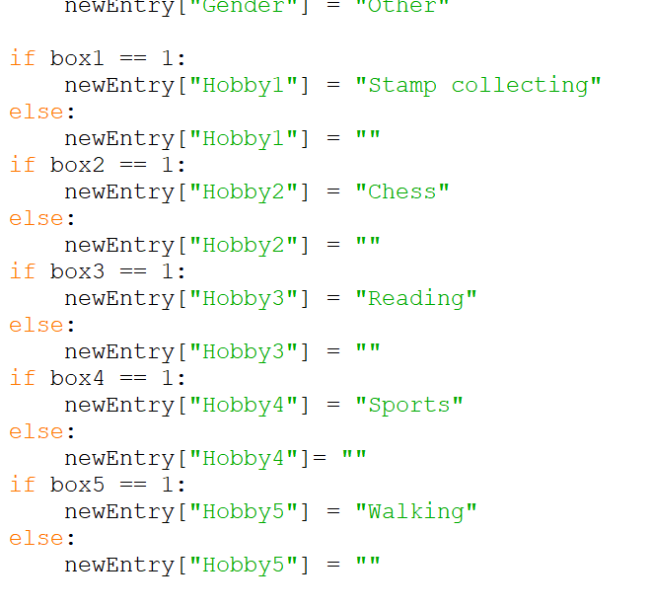
Tkinter – saving & loading
Method 1 - Saving a dictionary
The hobby code is a bit long winded, because we need to fill the hobby in as blank if they haven’t ticked the box.

Slide 11
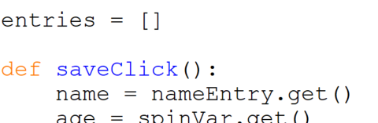
Tkinter – saving & loading
Method 1 - Saving a dictionary
Now that we’ve filled the new dictionary in we need to think about how to save it to a file.
Before we do that we need to make a new empty list to store the entries in. Add this in above the saveClick function.

Slide 12
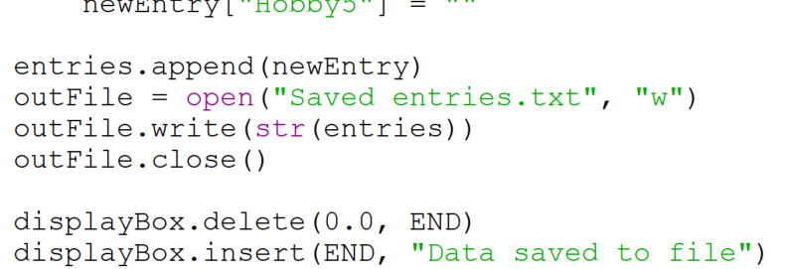
Tkinter – saving & loading
Method 1 - Saving a dictionary
Now go back down to the end of the saveClick function and add in the following code.
Adds the new dictionary to the end of the list
Opens the text file in write mode which overwrites any existing contents (this is intentional!)
Writes the list to the file, converting it to a string first (only strings can be written to text files)
Display text to the user to confirm save success

Slide 13

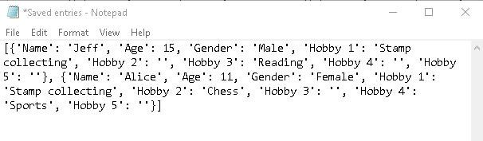
Tkinter – saving & loading
Method 1 - Saving a dictionary
Try running the code now. Fill in details and save for at least 2 people. Then, open the folder where you’ve saved the Python file, and you should find a text file called “ Saved entries”. Open this and check that it looks something like this:

Slide 14
Tkinter – saving & loading
Method 1 - Loading a dictionary
Saving the entries is good, but if we run the program again it will just forget everything we saved last time, so we need to add some code to our program to load the previously entered data.
We’re going to use the try-except validation technique you used back in lesson 2 (for checking dictionary items) to see whether the file exists or not.
Try-except is used to prevent the program from crashing. In this case, we’ll be trying to open a file in read mode. If this doesn’t exist it would cause an error, but instead of crashing we can tell it what to do instead using except.

Slide 15
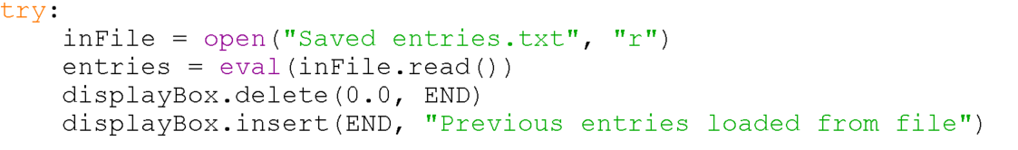
Tkinter – saving & loading
Method 1 - Loading a dictionary
At the bottom of your code (but before the window.mainloop line) add in the following code:
Attempt to open the file in read mode. If the file doesn’t exist it will give an error, but it won’t crash our program because it’s inside a try-except
Because our file contains a list of dictionaries, we can’t just read it in as a string. Wrapping it in “eval” means that Python will recognise it as a list full of dictionaries, so we overwrite the blank list we made at the top with the list read in from the file.

Slide 16
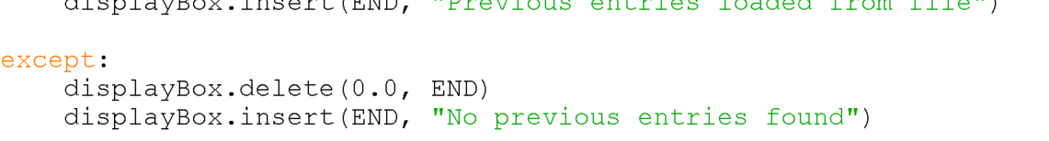
Tkinter – saving & loading
Method 1 - Loading a dictionary
Finally, add in the except code after the try code

Slide 17
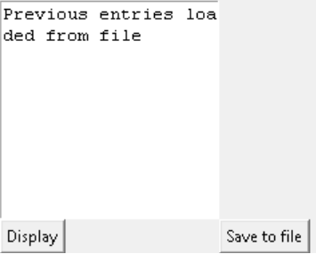
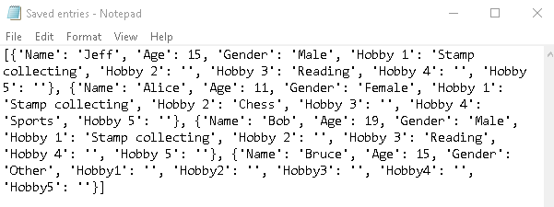
Tkinter – saving & loading
Method 1 - Loading a dictionary
Try running this code now. If you still have the “Saved entries.txt” file in your folder then it should say “Previous entries loaded from file” in the display box. If it doesn’t, check you’ve saved the file and check that you’ve named the file correctly in the code.
Then add some more entries and click save. Check that your text file now contains the previous entries AND the new ones.

Slide 18
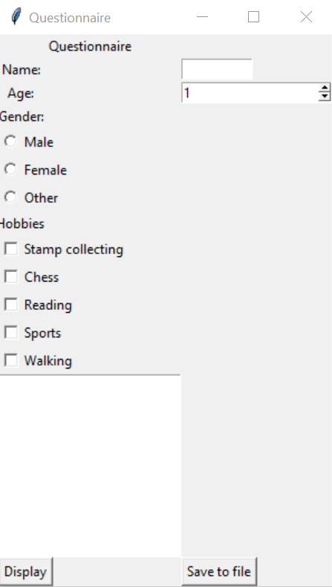
Activity 2
Add the save button to your window, and the code necessary to save the dictionary to a file. Make sure that when you press the save button it saves the data correctly.
Save your work as “lesson 4 activity 2”.
Extension:
Add two new buttons called “previous” and “next” to the code which allow the user to scroll through the different entries in the dictionary, displaying each in the display box.
Save this extension work as “lesson 4 activity 2 extension”

Slide 19
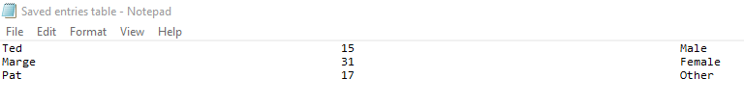
Tkinter – saving & loading
Method 2 – Saving & loading without a dictionary
The other method preferred by the WJEC is to not use a data structure in the code at all, but save the different bits of data to a text file as strings arranged in a sort of spaced out table like this:

Slide 20
Tkinter – saving & loading
Method 2 – Saving & loading without a dictionary
At this point, load up the “lesson 4 activity 3” code you saved earlier. If you didn’t do this, download a fresh copy of the “lesson 3 walkthrough solution” from Google classroom, then repeat o the steps on slides 5 & 6 to rename the “submit” button and function, and make a save button.

Slide 21
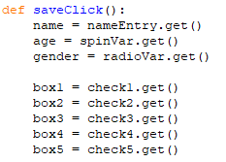
Tkinter – saving & loading
Method 2 – Saving & loading without a dictionary
We need to add in the save function again, and the first 8 lines are the same as they were last time.

Slide 22

Tkinter – saving & loading
Method 2 – Saving & loading without a dictionary
Rather than adding the different things into a dictionary, we need to prepare the variable to be saved into the file. Because it needs to be an evenly spaced out table, we use “.ljust” to add whitespace to the end of the string until it’s 50 characters long.
Because age comes as an integer, we need to cast it to a string before we can use .ljust

Slide 23
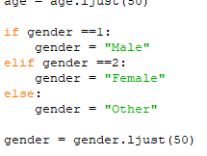
Tkinter – saving & loading
Method 2 – Saving & loading without a dictionary
The gender section looks similar to the previous method, but again we are just preparing the string variable rather than adding things to a dictionary.

Slide 24
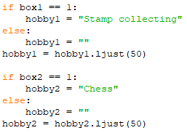
Tkinter – saving & loading
Method 2 – Saving & loading without a dictionary
Here’s what the code looks like for 2 of the 5 hobbies. Copy this in, then use it as a guide to add in the code for the other 3.

Slide 25
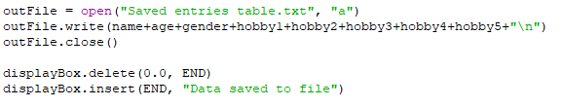
Tkinter – saving & loading
Method 2 – Saving & loading without a dictionary
Lastly we need to write the data out to the text file and tell the user we have done so. The file open code is similar, and the display code is exactly the same as last time.
Notice that we are opening the file in “a” (for append) mode this time – we are adding to the end of the file, not overwriting it each time
This line joins all of the strings together into one and adds a newline character “\n” at the end

Slide 26
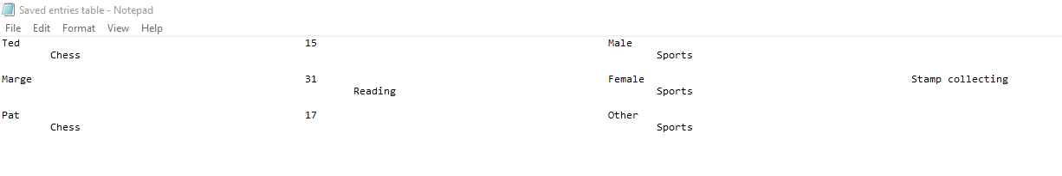
Tkinter – saving & loading
Method 2 – Saving & loading without a dictionary
Run this code now and try to save 3 different sets of data. Then, find the text file and check that it has created the table correctly. It might look like a jumbled mess when you first open it as shown below, but this is just because word wrap is on in Notepad.

Slide 27
Tkinter – saving & loading
Method 2 – Saving & loading without a dictionary
Now we’ve saved the data in a text file, we can count the number of items or view the data for items that match certain search terms input by the user.
This is a little tricky, so we will leave that for the next tutorial.

Slide 28
Activity 3
Implement the saved entry table method and make sure the data is being correctly saved.
Save your work as “lesson 4 activity 3”.

Slide 29
Uploading your work
You should now have 2 complete Python files from today’s lesson (plus any extension work). On Google classroom you will find an assignment for this lesson, and you need to upload your completed Python file to this assignment.
If you have any problems doing this, please speak to your teacher.

